Slide 1


HUMAN PERFORMANCE LAB
Redefining athlete development through data intelligence and technology.
01 / 38
Pitch Deck · July 2026

Slide 2


Executive Summary.
This Project is redefining athlete development through data intelligence and technology, turning raw performance data into personalized training insights. By addressing the main reasons young players drop out and helping clubs optimize talent growth, Sport IQ builds a connected ecosystem between sports, health, education, and innovation.
Sport IQ is shaping the future of athlete performance — scalable, measurable and sustainable.

Slide 3
01
Context.
CHAPTER · 01

Slide 4
01 CONTEXT
The Portuguese Context.
773,845
total registered athletes in Portugal in 2023 (Notícias ao Minuto)
And of these, how many truly succeed?
Does the current training system truly promote athlete development and success?
501,483
young athletes in the "youth development categories, up to juniors" (Sportinforma)
154,437
estimated football athletes under 18 (total registered 2023/24 ≈ 238,313) (FPF)
~7,700
athletes sign any type of contracts
(0.5% of 154,437)

Slide 5
01 CONTEXT
A Very Narrow Funnel.
The football development system is a very narrow funnel : thousands enter, few survive, and only a handful reach sustainable professional careers.
0.5%
154,437
90-95%
7 / 10
In Europe, UEFA data shows that only 0.5% of players with a youth academy contract sign a professional deal
Estimated football athletes under 18 (total registered players for the 2023/24 season ≈ 238,313) (FPF)
In countries like Portugal and Brazil, national studies indicate that 90–95% of players drop out before the age of 18
According to studies by FIFA and the CBF Academy, 7 out of 10 youth players feel forgotten within their own club

Slide 6
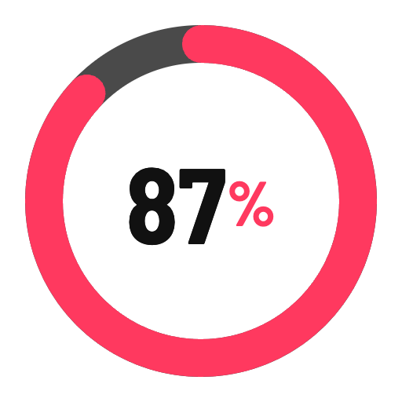
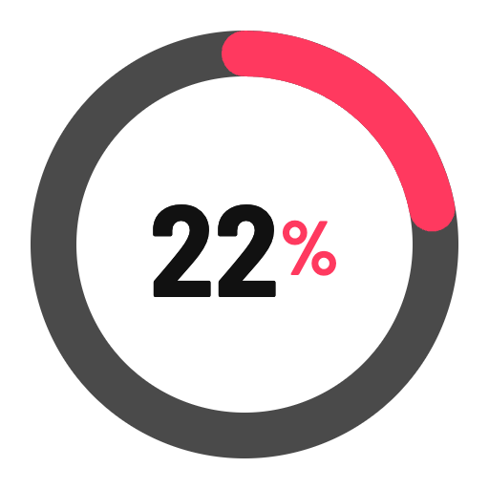
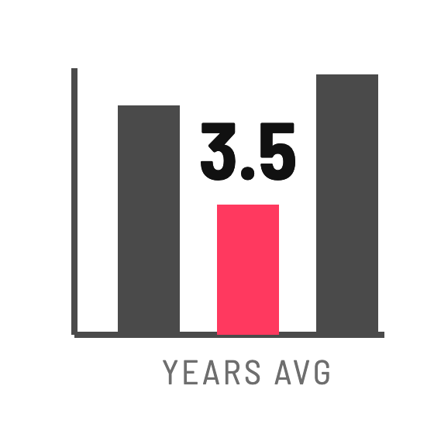
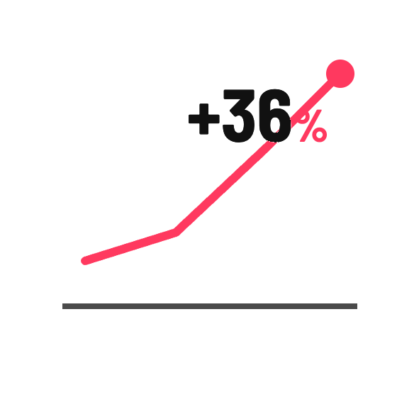
01 CONTEXT
Supporting Data.
87% of countries surveyed have no data-driven talent tracking systems
FIFA Talent Development Report (2022)
Only 22% of European academies use integrated performance platforms
UEFA Academy Survey (2023)
Average retention in youth academies is just 3.5 years
CIES Football Observatory
Players with individualized development plans are 36% more likely to reach professional level
Aspire Academy Study (Qatar, 2021)

Slide 7
02
Main Causes of Dropout and Attrition.
CHAPTER · 01

Slide 8

02 MAIN CAUSES OF DROPOUT AND ATTRITION
Why So Many Youth Players Start, And So Few Reach The Top?

Slide 9

02 MAIN CAUSES OF DROPOUT AND ATTRITION
01
Early Specialization & Burnout.
OPPORTUNITY
Balance training loads through data analytics, encourage multi-sport movement patterns, and monitor fatigue with wearables.
● Children often specialize too early in football, training year-round with little variation (except goalkeepers)
● By ages 12–14, many experience mental and physical exhaustion, loss of enjoyment, and a sense of "job pressure"
● Research (American Academy of Pediatrics, UEFA, IOC) shows that early specialization increases injury risk by 70% and triples dropout likelihood by age 15

Slide 10

02 MAIN CAUSES OF DROPOUT AND ATTRITION
02
Pressure from Adults (Parents & Coaches).
OPPORTUNITY
Integrate psychological tracking, family workshops and emotional intelligence programs to maintain intrinsic motivation.
● Many young athletes quit because the joy of playing is replaced by the fear of disappointing parents or coaches
● Constant focus on winning, selection or future contracts creates performance anxiety
● According to the English FA, 30–40% of youth players report that external pressure was the main reason they stopped playing

Slide 11

02 MAIN CAUSES OF DROPOUT AND ATTRITION
03
Lack of Personalized Development.
OPPORTUNITY
Continuous monitoring of biological age, performance and skill acquisition using data to individualize training paths.
● Traditional academies often run uniform training programs that ignore each player's growth stage, physical maturity or learning style
● Late developers are often cut too early simply because they don't fit physical criteria at age 13 or 14
● These "lost talents" could have succeeded with personalized progression plans

Slide 12

02 MAIN CAUSES OF DROPOUT AND ATTRITION
04
Injuries and Poor Load Management.
OPPORTUNITY
Predictive load management, recovery tracking and medical monitoring integrated into the development plan.
● Growth-related injuries (like Osgood-Schlatter or stress fractures) are common between ages 11–15
● Overtraining and poor recovery routines lead to chronic issues
● Players often lack medical or physiotherapy support at early stages, pushing them to quit out of frustration

Slide 13

02 MAIN CAUSES OF DROPOUT AND ATTRITION
05
Lack of Fun and Engagement.
OPPORTUNITY
Combine serious training with immersive, gamified and tech-enhanced learning experiences (AR/VR, feedback platforms, progress dashboards).
● Between ages 10–14, motivation shifts from playfulness to performance; fun disappears
● Without gamified, engaging and emotionally rewarding experiences players disconnect
● Studies (FIFA, 2022) show "loss of enjoyment" is the #1 self-reported reason for quitting before age 15

Slide 14

02 MAIN CAUSES OF DROPOUT AND ATTRITION
06
Educational & Social Pressure.
OPPORTUNITY
Hybrid education models, tutoring and personalized study-performance balance supported by data tracking.
● Around age 14–16, school demands increase while training intensifies — the system forces a choice
● Families often prioritize education due to uncertainty about football careers
● Inadequate academic support programs inside academies lead to dropout among academically strong players

Slide 15

02 MAIN CAUSES OF DROPOUT AND ATTRITION
07
Lack of Clear Pathway & Visibility.
OPPORTUNITY
Transparent performance dashboards showing measurable growth and development benchmarks.
● Many young players quit because they don't see a realistic future — the pathway from academy to professional football is opaque
● Lack of feedback or metrics makes them believe "I'm not progressing"
● This uncertainty leads to disengagement, especially around age 15–17

Slide 16

02 MAIN CAUSES OF DROPOUT AND ATTRITION
08
Selection Bias & Inequality.
OPPORTUNITY
Data-based talent identification models that remove bias and support equal opportunity based on long-term potential.
● Traditional scouting favors early physical maturity, neglecting cognitive or tactical intelligence
● Late bloomers are cut, while early maturers plateau
● Socioeconomic inequality also limits access to structured development environments

Slide 17
02 MAIN CAUSES OF DROPOUT AND ATTRITION
Causes & Impact.
CATEGORY | CAUSES | IMPACT
Psychological Factors | Lack of confidence, fear of failure, excessive pressure, burnout, negative comparisons | Loss of motivation, early dropout
Physical Factors | Injuries, overtraining, poor recovery routines, lack of load management | Reduced physical performance, chronic issues
Developmental Factors | Non-individualized training, absence of feedback, lack of data-driven progression plans | Technical and physical stagnation
Educational & Family Factors | Difficulty balancing school and sport, lack of family support, unrealistic expectations | Emotional instability and disengagement
Organizational & Structural Factors | Poor scouting, lack of player follow-up, no objective performance indicators | Talent loss due to systemic inefficiency
Economic & Social Factors | High costs, inequality of opportunity, lack of scholarships or financial support | Exclusion of lower-income talent

Slide 18
02 MAIN CAUSES OF DROPOUT AND ATTRITION
Structural Flaws in the Traditional Model.
● Standardized training: everyone trains the same but develops differently
● Limited monitoring: fragmented between physical, technical and psychological aspects
● Lack of integration between performance, health and education
● Decisions based on perception, not evidence
● No longitudinal data tracking of athletes' progression over time
These weaknesses explain why so many players never reach their full potential:
Not due to lack of talent, but because their development process is not personalized, monitored or optimized.

Slide 19

02 MAIN CAUSES OF DROPOUT AND ATTRITION
In Summary.
Most early dropouts aren't caused by lack
of talent, but by lack of system intelligence.
Players leave because the system:
● overloads them physically
● pressures them emotionally
● understimulates them cognitively
● fails to personalize their journey

Slide 20
03
Opportunity.
CHAPTER · 01

Slide 21

03 OPPORTUNITY
The Opportunity.
This Project was designed to solve these structural inefficiencies by using data and technology to create a smarter and more human-centered approach to athlete development.
Its model focuses on:
01
Continuous monitoring of technical, physical and emotional evolution.
02
Individualized and adaptive training plans built on objective data.
03
Predictive analytics to reduce injuries and burnout.
04
Integration of educational, family and psychological support within the training ecosystem.
Transforming player development into a measurable, sustainable process that combines performance, well-being and human growth.

Slide 22
03 OPPORTUNITY
What Is Sport IQ?
Using data and technology to create a smarter and more human-centered approach to athlete development.
An integrated ecosystem with all the data that helps a football player (and in the future all athletes) to have better development, better evolution and better performance.
Its model focuses on:
L
T
A
D
A
Long
Term
Athletes
Development
Approach

Slide 23

03 OPPORTUNITY
SPORT IQ: WHERE DATA MEETS PERFORMANCE
Football talent is no longer built only on intuition and talent.
It's also built on data, information and technology.
Sport IQ is a new-generation project that combines sports science, technology and data analytics to redefine how young athletes are developed.
Our mission is simple yet powerful:
To give every player an edge — a measurable competitive advantage — through personalized, data-driven training and scientific performance tracking.

Slide 24
03 OPPORTUNITY
Sport IQ
where
data meets performance
We are building a long-term athlete development ecosystem supported by technology such as:
Wearables that track physical and cognitive performance.
AI-powered analytics that transform data into insight.
Digital platforms that connect coaches, athletes, and families in real time.
But Sport IQ is more than a football academy.
It’s also a venture builder, creating and financing startups that design the tools, devices, and platforms we use to train and measure talent.
By developing and later commercializing these technologies, we create
a dual revenue model — one from athletic training, and one from scalable tech ventures.
Our vision is to become the benchmark for data-driven athlete development, setting a new
global standard for how young players train, evolve and reach professional performance.
At Sport IQ, we don’t
just train players.
We engineer performance.

Slide 25
04
Activity Areas.
CHAPTER · 01

Slide 26


04 ACTIVITY AREAS
Activity Areas.
A connected ecosystem designed to develop talent, technology and business in sports — integrating data, science and innovation across four strategic verticals.
TALENT DEVELOPMENT
ATHLETE HEALTH & PERFORMANCE
SPORTS ENTERTAINMENT
SPORTS
Building the infrastructure, technology and management systems that power the sports industry.
Educating and empowering the next generation of coaches, analysts and sports professionals.
Enhancing athletic performance through science, data and integrated health monitoring.
Connecting fans, athletes and brands through immersive and digital experiences.

Slide 27

04 ACTIVITY AREAS
Sports.
● Infrastructure and training facilities (indoor and outdoor), training equipment (wearables and beyond) and training technologies that power the physical and technical development of athletes.
● Software solutions, management platforms and applications for clubs and academies, scouting and performance analysis technologies, e-commerce and marketplaces for sports products, and solutions for sports event management.
● Data collection and analytics systems, and tools for monitoring technical, tactical, and physiological development, as well as performance and training evolution across age categories.

Slide 28
04 ACTIVITY AREAS
Sports.
KEY OFFERS & VENTURES (EXAMPLES)
●
●
●
●
●
●
SportIQ Football Academy:
Data-driven player development academy.
Performance Data Platform:
Central BI system integrating all wearable and video analytics data.
Sports Events & Tournaments:
Data-powered competitions with performance analytics.
SportIQ Tech Solutions:
SaaS and digital tools for club and academy management (training, communication, scheduling, reporting).
Smart Training Equipment:
Wearables, tracking cameras, and IoT sensors for training environments.
E-commerce & Marketplaces:
Digital platforms for sports products, technology licensing and academy merchandising.
MONETIZATION
Subscription models, technology licensing and academy tuition. Sale of proprietary or white-label tech developed through the CVB.

Slide 29

04 ACTIVITY AREAS
Talent Development.
● Creation of specialized courses, immersive programs, and internships for professionals and students connected to the sports industry who need to develop technological and analytical skills to operate in the new data-driven sports ecosystem.
● This includes programs focused on sports data analytics, performance science, digital transformation and innovation management in sports, delivered in partnership with universities, federations and technology companies.
● The goal is to build a new generation of professionals capable of integrating technology, performance and business intelligence, ensuring the sustainable growth of the sports industry and its digital transition.

Slide 30
04 ACTIVITY AREAS
Talent Development.
KEY OFFERS & VENTURES (EXAMPLES)
●
●
●
●
●
SportIQ Learning Hub:
Executive courses, certificates and digital training for sports professionals (coaches, analysts, scouts, physios).
Internship Programs:
Placement of students in clubs, academies and startups across the ecosystem.
Certification Programs:
Recognized badges in areas such as "Sports Data Analyst," "Performance Technologist" or "Football Intelligence Coach."
Immersive Bootcamps:
Hands-on programs combining tech and field experience (data analysis, performance monitoring, tactical modeling).
SportIQ Academy Lab:
Innovation lab where students and startups co-develop prototypes and performance solutions.
MONETIZATION
Tuition and licensing of courses. Corporate training partnerships with federations and clubs. Joint ventures with universities and education platforms.

Slide 31

04 ACTIVITY AREAS
Athlete Health &
Performance.
● Wearables and sensors for performance monitoring and injury prevention, sports medicine and telemedicine platforms, intelligent nutrition and supplementation.
● Recovery and rehabilitation technologies, biometric data analysis, physiotherapy and training progression tools, alongside emotional and psychological monitoring and support solutions.

Slide 32
04 ACTIVITY AREAS
Athlete Health & Performance.
KEY OFFERS & VENTURES (EXAMPLES)
●
●
●
●
●
●
SportIQ Performance Lab:
Sports science center for physical, biomechanical and cognitive testing.
Telemedicine Platform:
Sports medicine, physiotherapy and rehabilitation supported by data analytics.
Mental & Emotional Health Apps:
Cognitive coaching, resilience training and well-being tracking.
Wearables & Smart Monitoring:
GPS, HRV, motion sensors and sleep trackers integrated in real time.
Nutrition & Recovery Systems:
Smart supplementation and personalized recovery technologies (Normatec, cryo, etc.).
Data-Driven Fitness Programs:
Personalized plans for amateur and semi-professional athletes.
MONETIZATION
Subscription and B2B licensing to clubs and health providers. Partnerships with wearable brands and health tech startups. Commercialization of proprietary AI-based performance models.

Slide 33

04 ACTIVITY AREAS
Sports Entertainment.
● E-sports and gaming platforms, immersive fan experiences (VR/AR), interactive content and streaming solutions, fan engagement and audience monetization platforms, fantasy sports and innovative sports betting experiences.
● This sectoral focus leverages the expertise of all partners and targets a market with high growth and digital transformation potential, using data and technology to enhance and evolve athletes, clubs, and all key stakeholders across the sports ecosystem — in football and beyond.

Slide 34
04 ACTIVITY AREAS
Sports Entertainment.
KEY OFFERS & VENTURES (EXAMPLES)
●
●
●
●
●
●
SportIQ eSports & Gaming Platform:
Virtual football leagues and tournaments powered by analytics.
VR/AR Experiences:
Immersive match simulations and fan training environments.
Fantasy Sports & Predictive Platforms:
AI-powered insights and interactive competitions.
Fan Engagement Apps:
Gamified experiences, collectible data cards, and interactive training challenges.
Streaming & Content Production:
Storytelling, data storytelling, and athlete performance documentaries.
NFTs & Digital Assets:
Tokenization of athlete performance and academy highlights.
MONETIZATION
Sponsorships, digital audience monetization and brand partnerships. Licensing of content and entertainment IP. Integration with gaming and metaverse ecosystems.

Slide 35


04 ACTIVITY AREAS
Interconnection of the Ecosystem.
All verticals are connected through the Sport IQ Corporate Venture Builder (CVB) — the core engine that:
Finances, incubates and accelerates startups across these four verticals.
Ensures cross-learning between sports, tech, health and education.
Generates multiple revenue streams: tech licensing, data monetization, startup exits, and service subscriptions.

Slide 36
05
The Project
SPORT IQ.
CHAPTER · 01

Slide 37
05 THE PROJECT SPORT IQ
Data Structure.
Institution
School
School
Group
Group
Group
Group
Athletes
Athletes
Athletes
Athletes

Slide 38
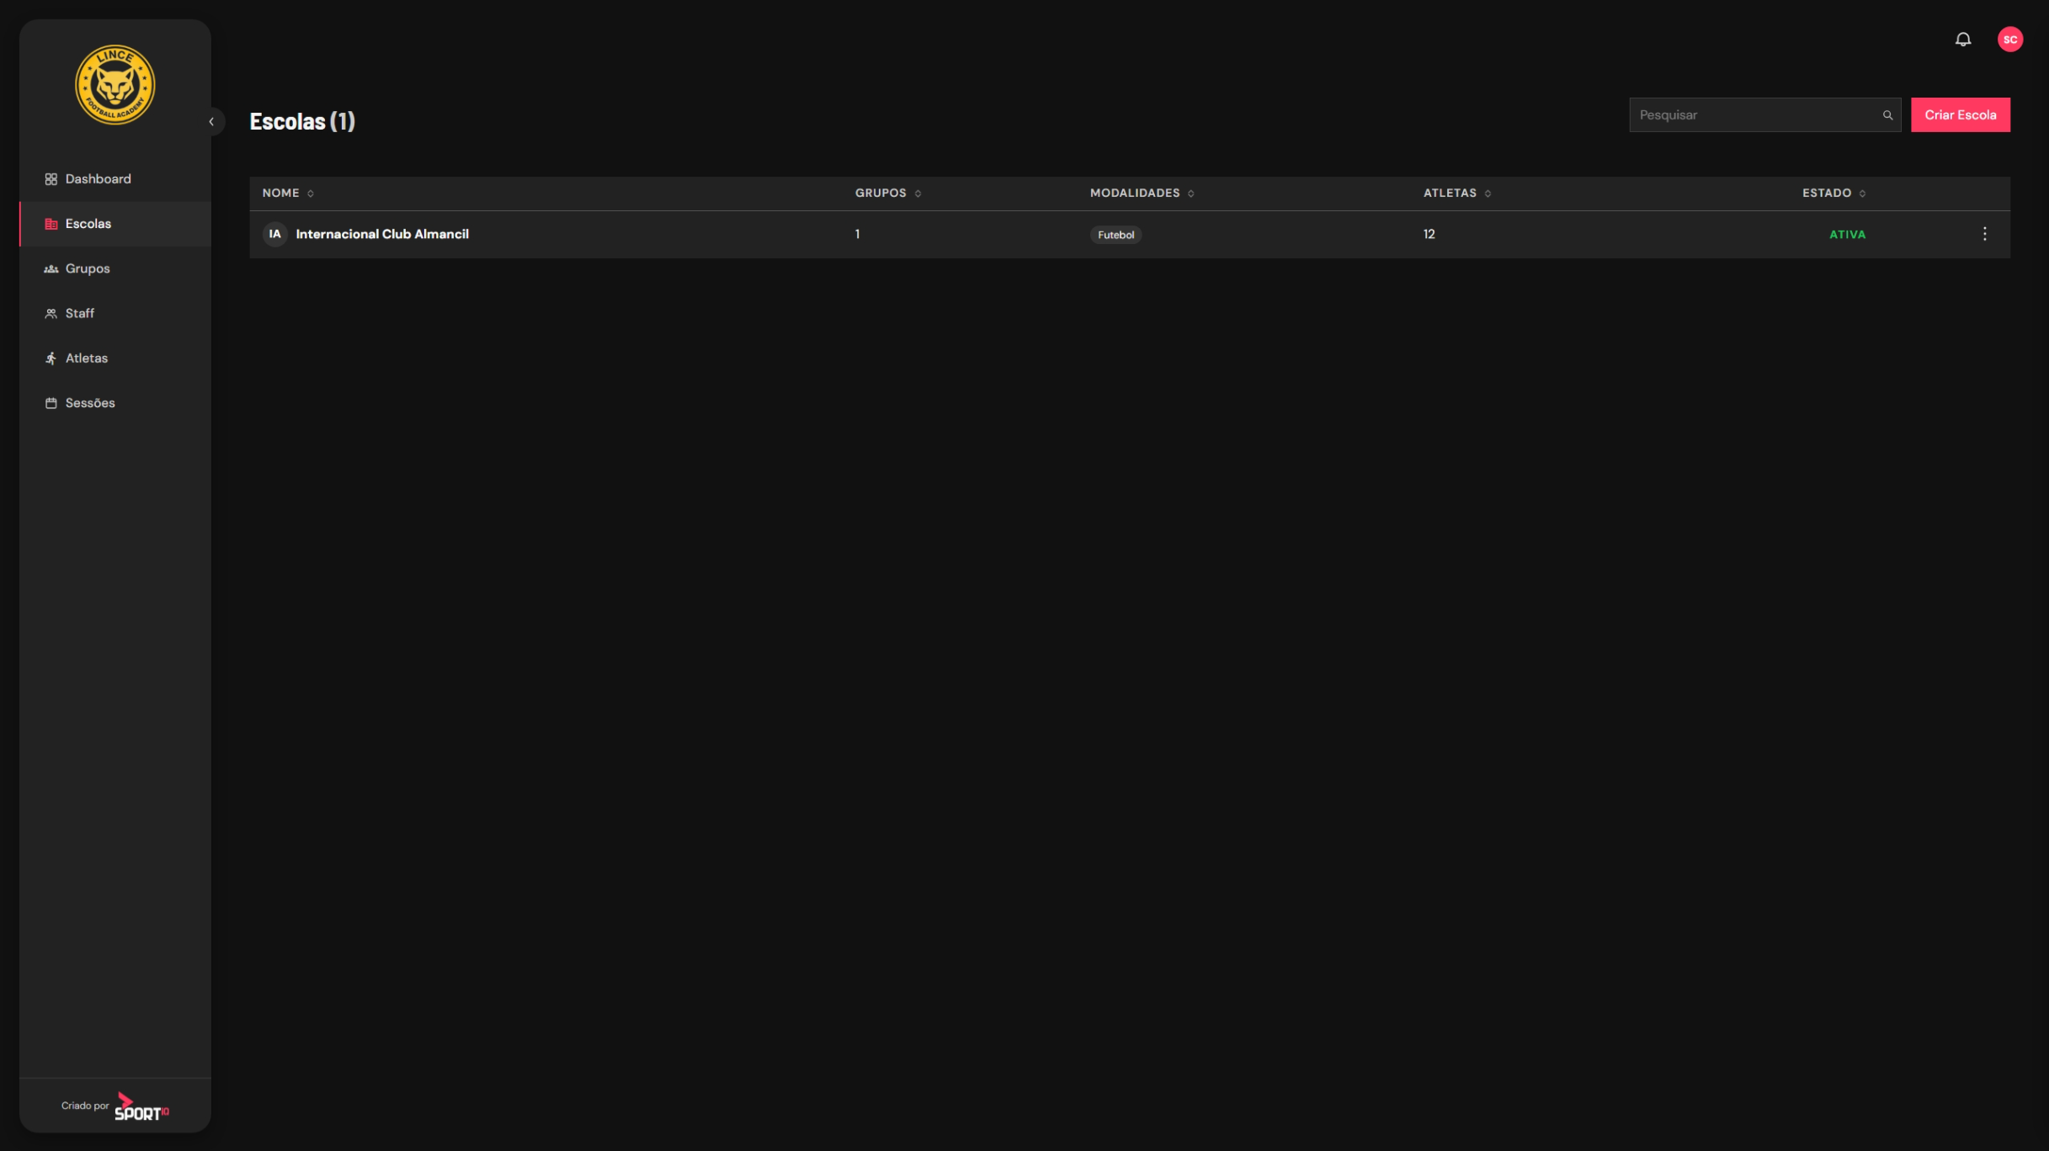


Slide 39
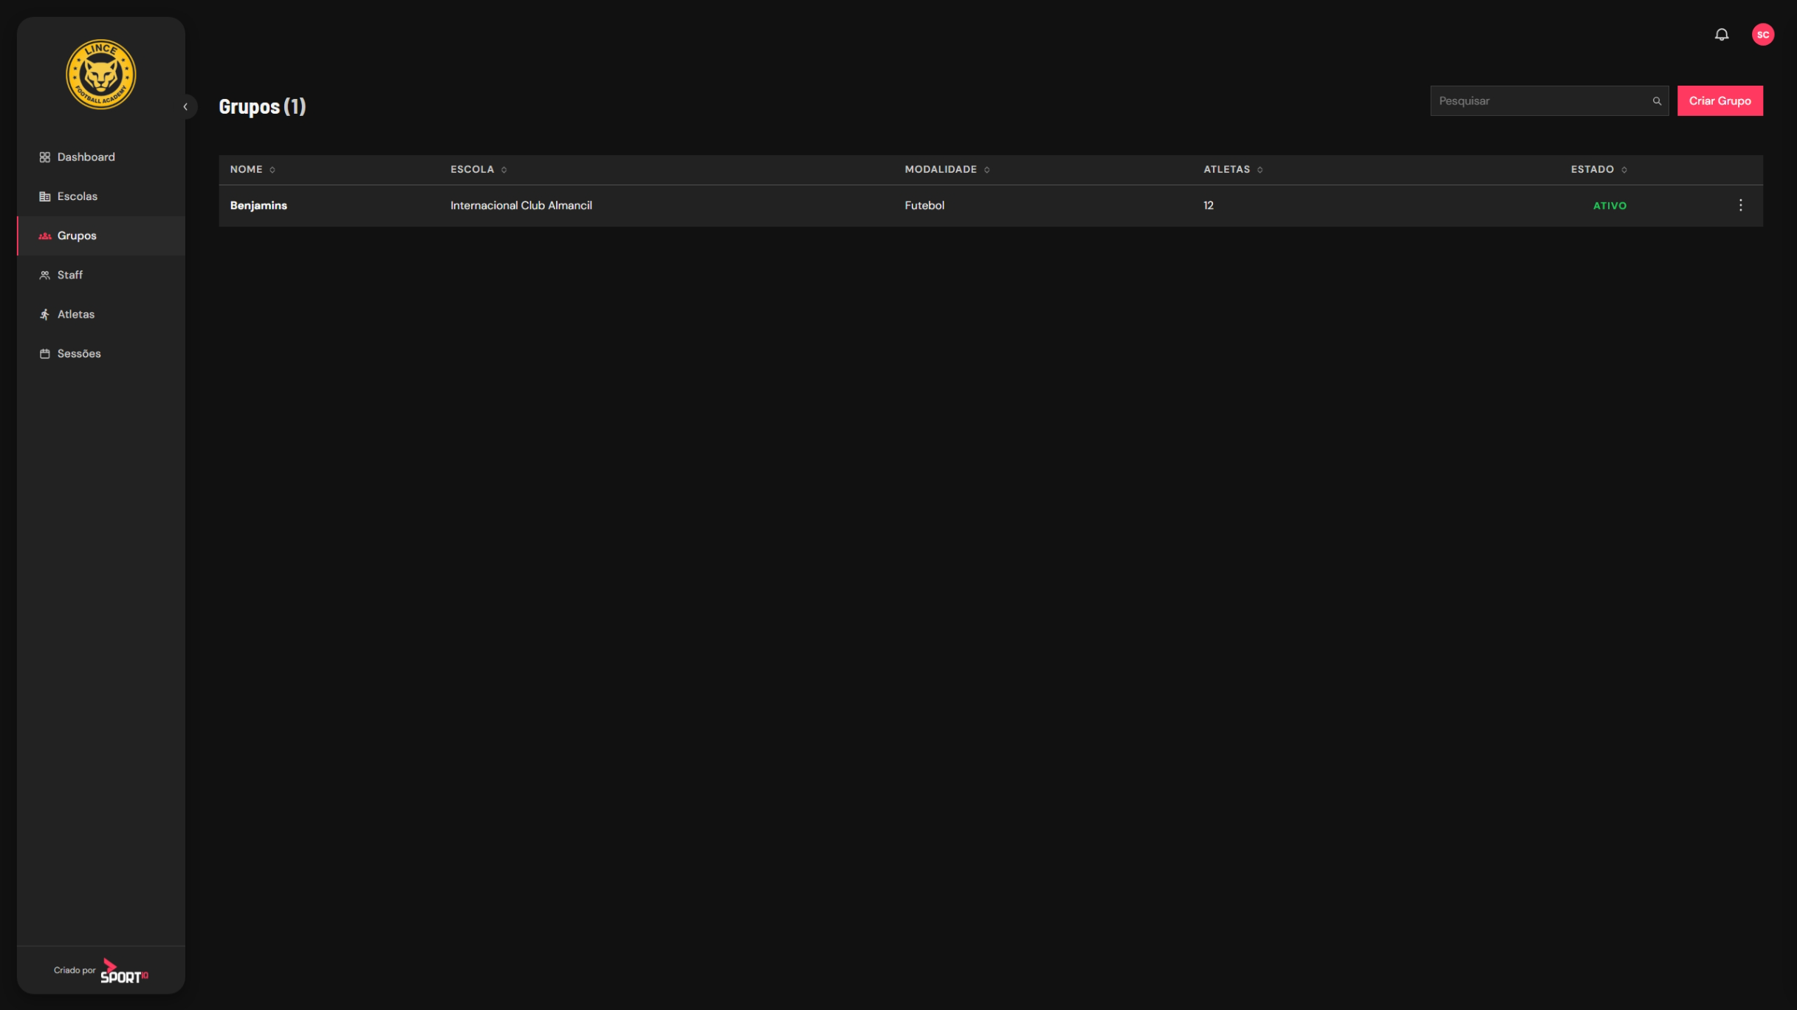

Slide 40
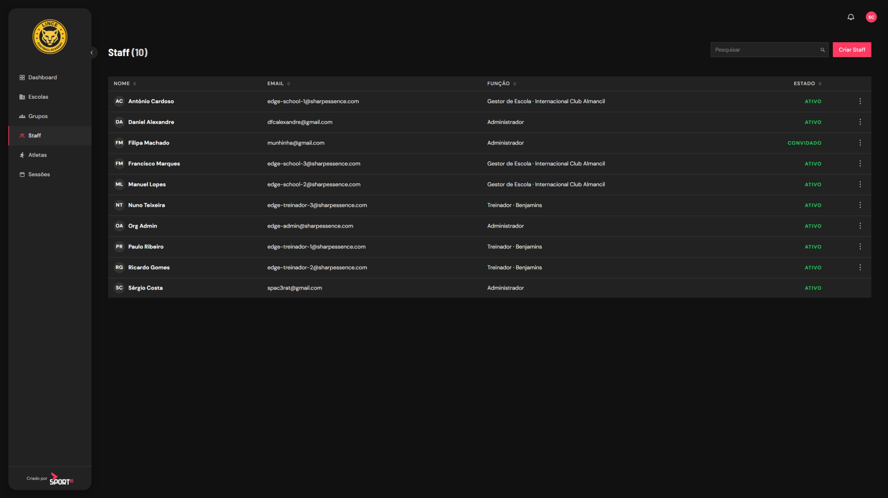

Slide 41
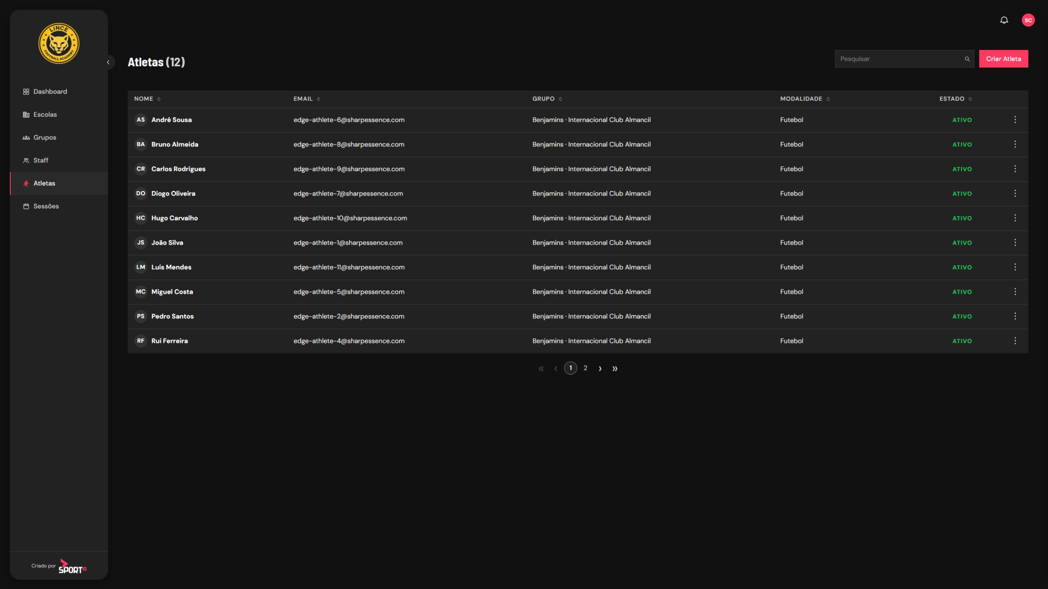

Slide 44
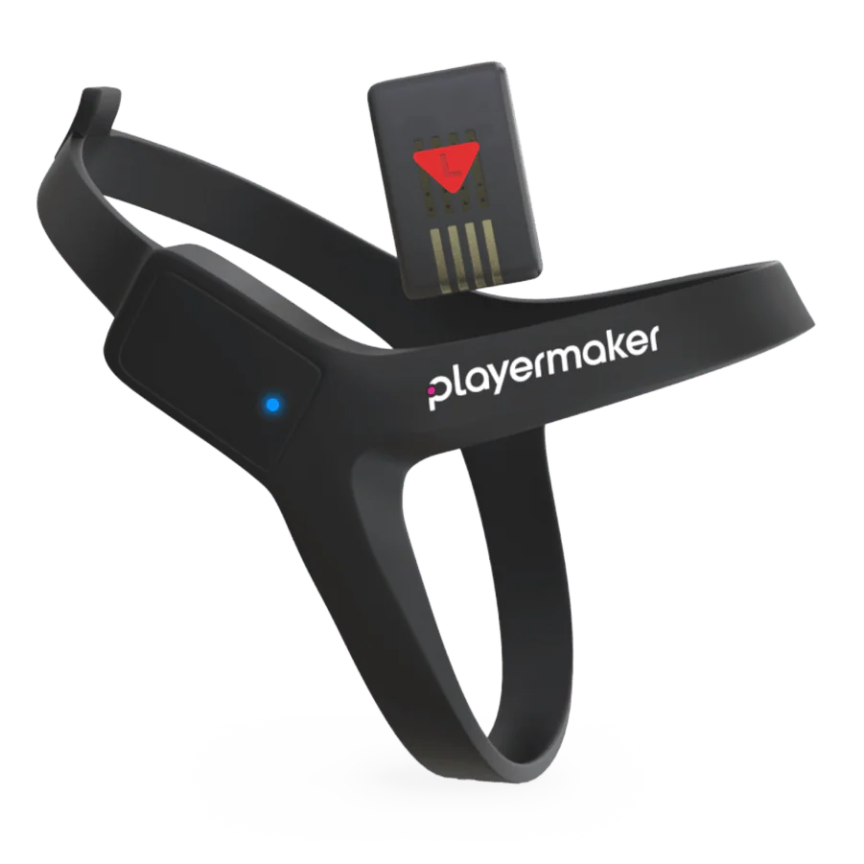
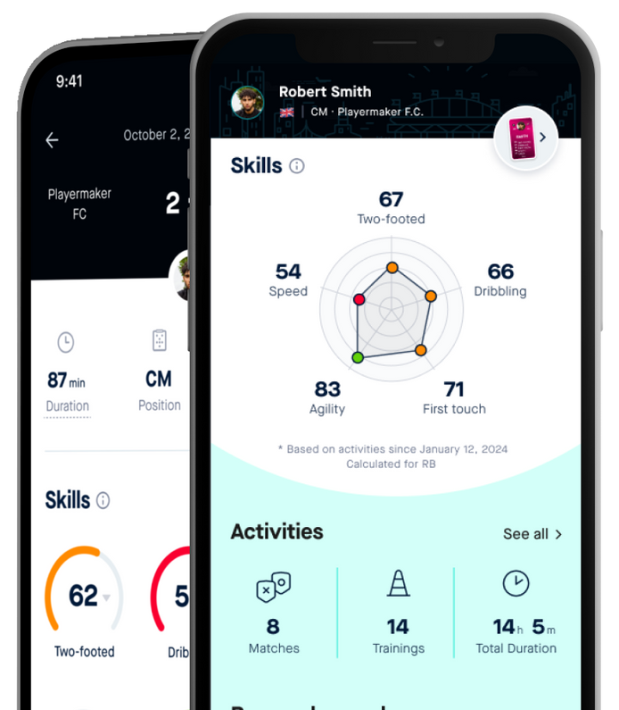

05 THE PROJECT SPORT IQ

Slide 45
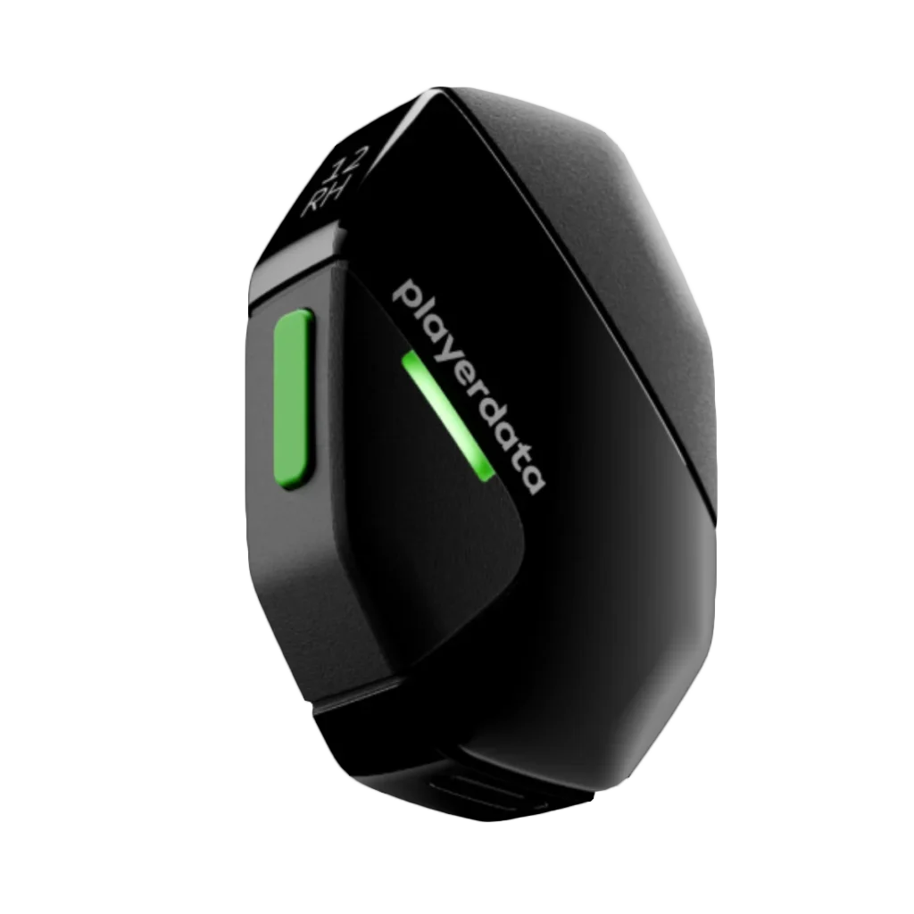
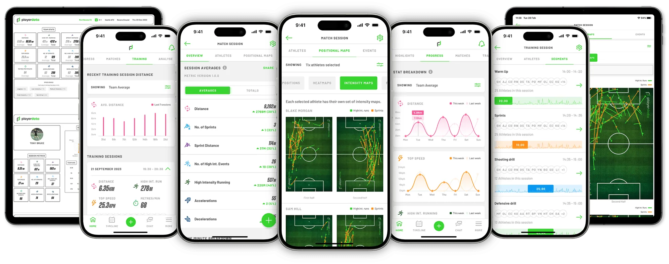

05 THE PROJECT SPORT IQ

Slide 46

05 THE PROJECT SPORT IQ

Slide 47
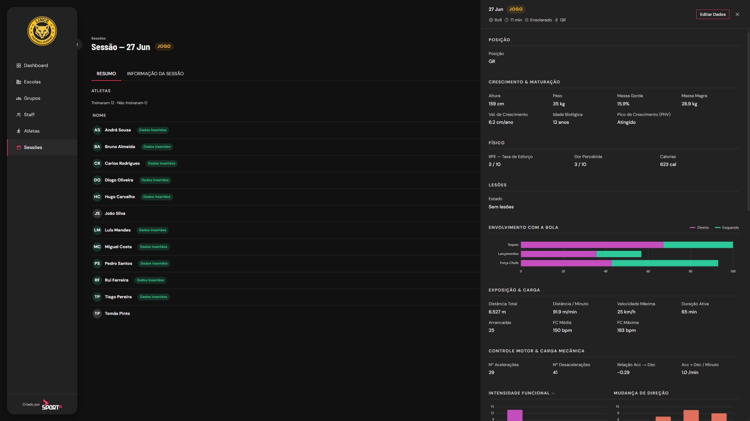

Slide 48
05 THE PROJECT SPORT IQ
Athlete Data.
PERFORMANCE
PHYSICAL
WELL-BEING
● TES: Technical Evolution Score
● TIS: Tactical Intelligence Score
● Load per session
● Technical development
● Passing
● Receiving
● Dribbling
● Aerial play
● Decision-making
● Tactical data
● Positioning
● Game reading
● Consistency
● Positional KPI
● RPE – Rate of Perceived Exertion
● Perceived pain
● Calories
● Injuries
● Maturation
● Biological age
● Chronological age
● Body composition
● Lean mass
● Fat mass
● Total weight
● Height
● Growth velocity and PHV
● Wellbeing index
● Psychological
● Family/school
● Physiological
● Commitment
● Training-school conflict
● Psychosocial radar
● Motivation
● Confidence
● Resilience
● Stress management
● Family support
● Nutrition
● Academic performance
● Physiological readiness
● Sleep
● Fatigue
● HRV

Slide 49



Slide 51
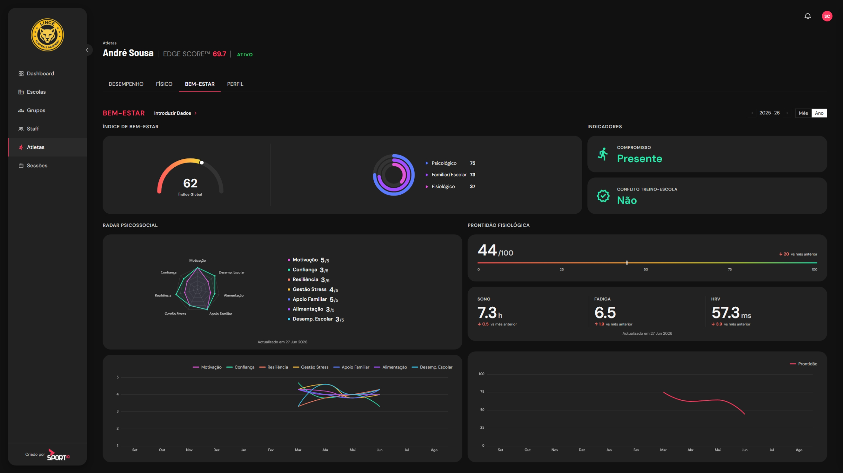

Slide 52

05 THE PROJECT SPORT IQ
Meet Eddi & Hannah.
They are the AI companions inside the Sport IQ app.
Two conversational AI coaches available 24/7, turning performance data into simple, human guidance for athletes, coaches and families right when they need it.

Slide 53
05 THE PROJECT SPORT IQ
Meet Eddi & Hannah.
They access all relevant real-time data, both individual and for groups/teams.
Offer personalized advice suited to your area of expertise: physical condition / nutrition and wellbeing.

Slide 54
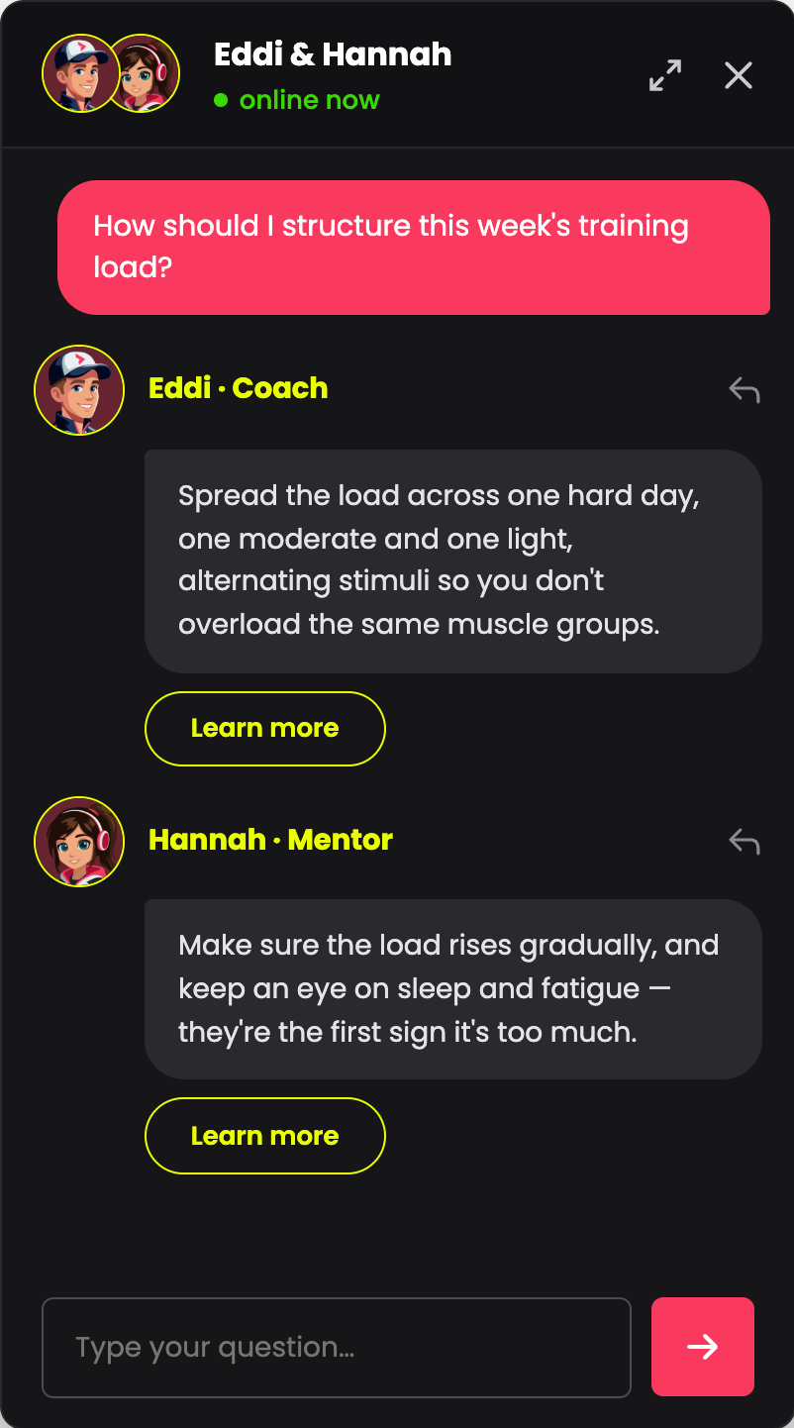
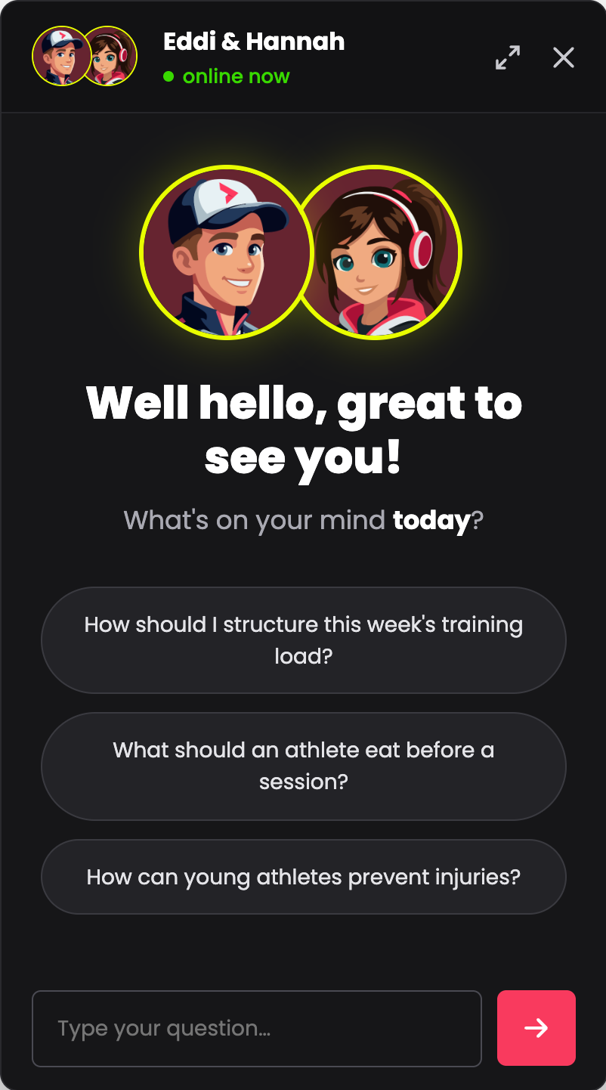
05 THE PROJECT SPORT IQ
Not just data.
A conversation.
Eddi and Hannah make performance intelligence feel human, accessible and always within reach.

Slide 55


05 THE PROJECT SPORT IQ
HANNAH.
Human and Nutrition Assistant
Mentor · Health & Wellbeing
Hi! I'm Hannah, your health and wellbeing mentor.
I focus on recovery, nutrition, sleep and injury prevention. Ask me how to prevent injuries, build better recovery routines or take care of your body and mind.

Slide 56

05 THE PROJECT SPORT IQ
EDDI.
Edge Digital Intelligence
Coach · Performance & Training
Hi! I'm Eddi, your performance coach.
I help you plan your training, manage your load and get the most out of every session. Ask me how to structure your week, what to do before a session, or how to turn your data into your next move.

Slide 57
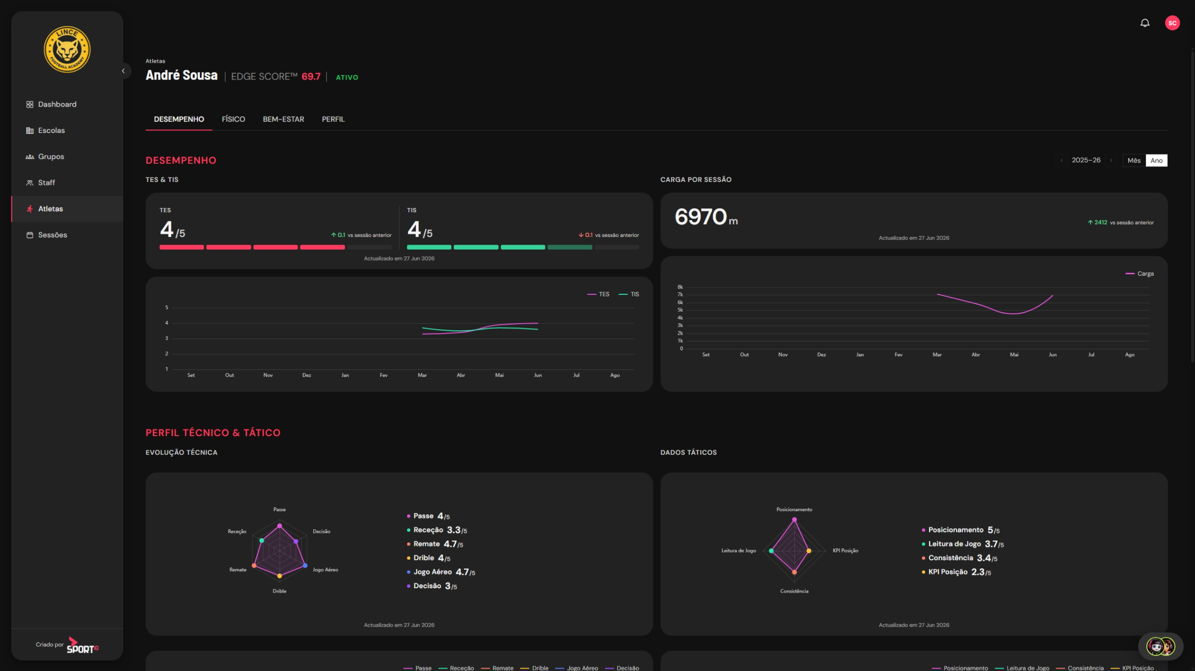

Slide 58
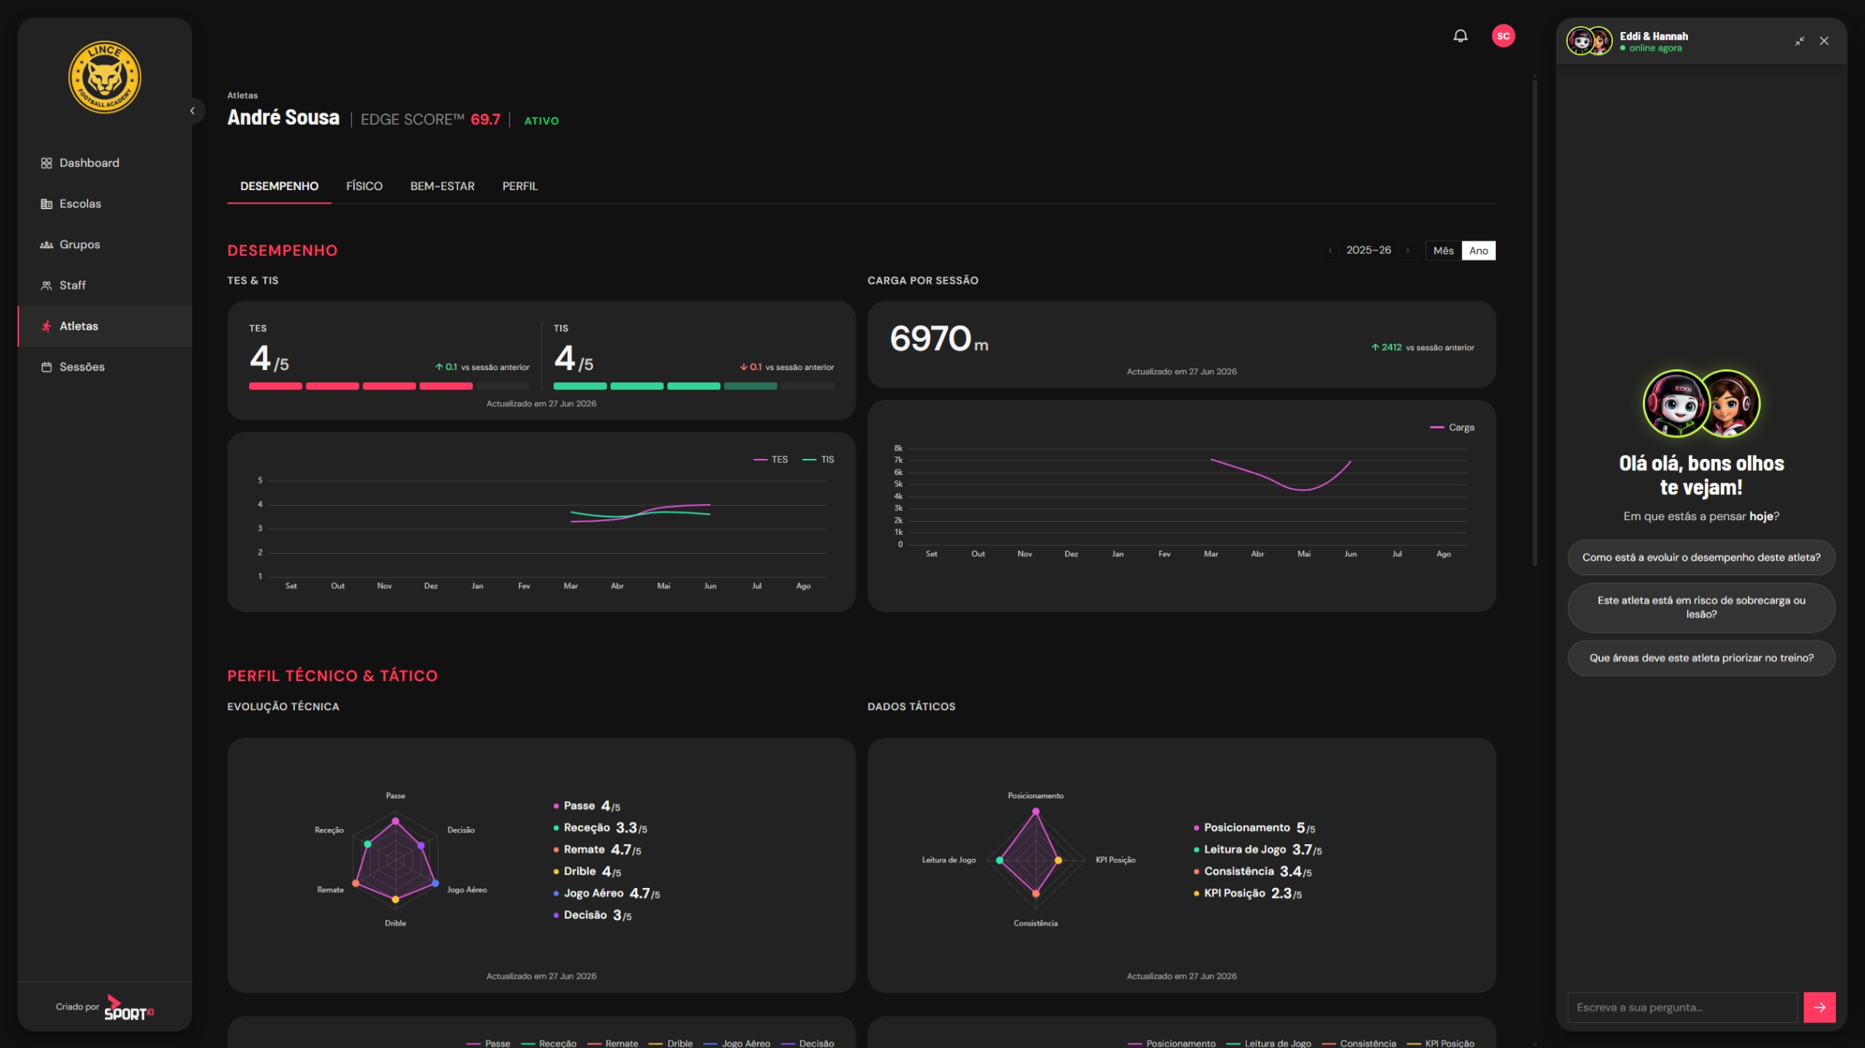

Slide 59
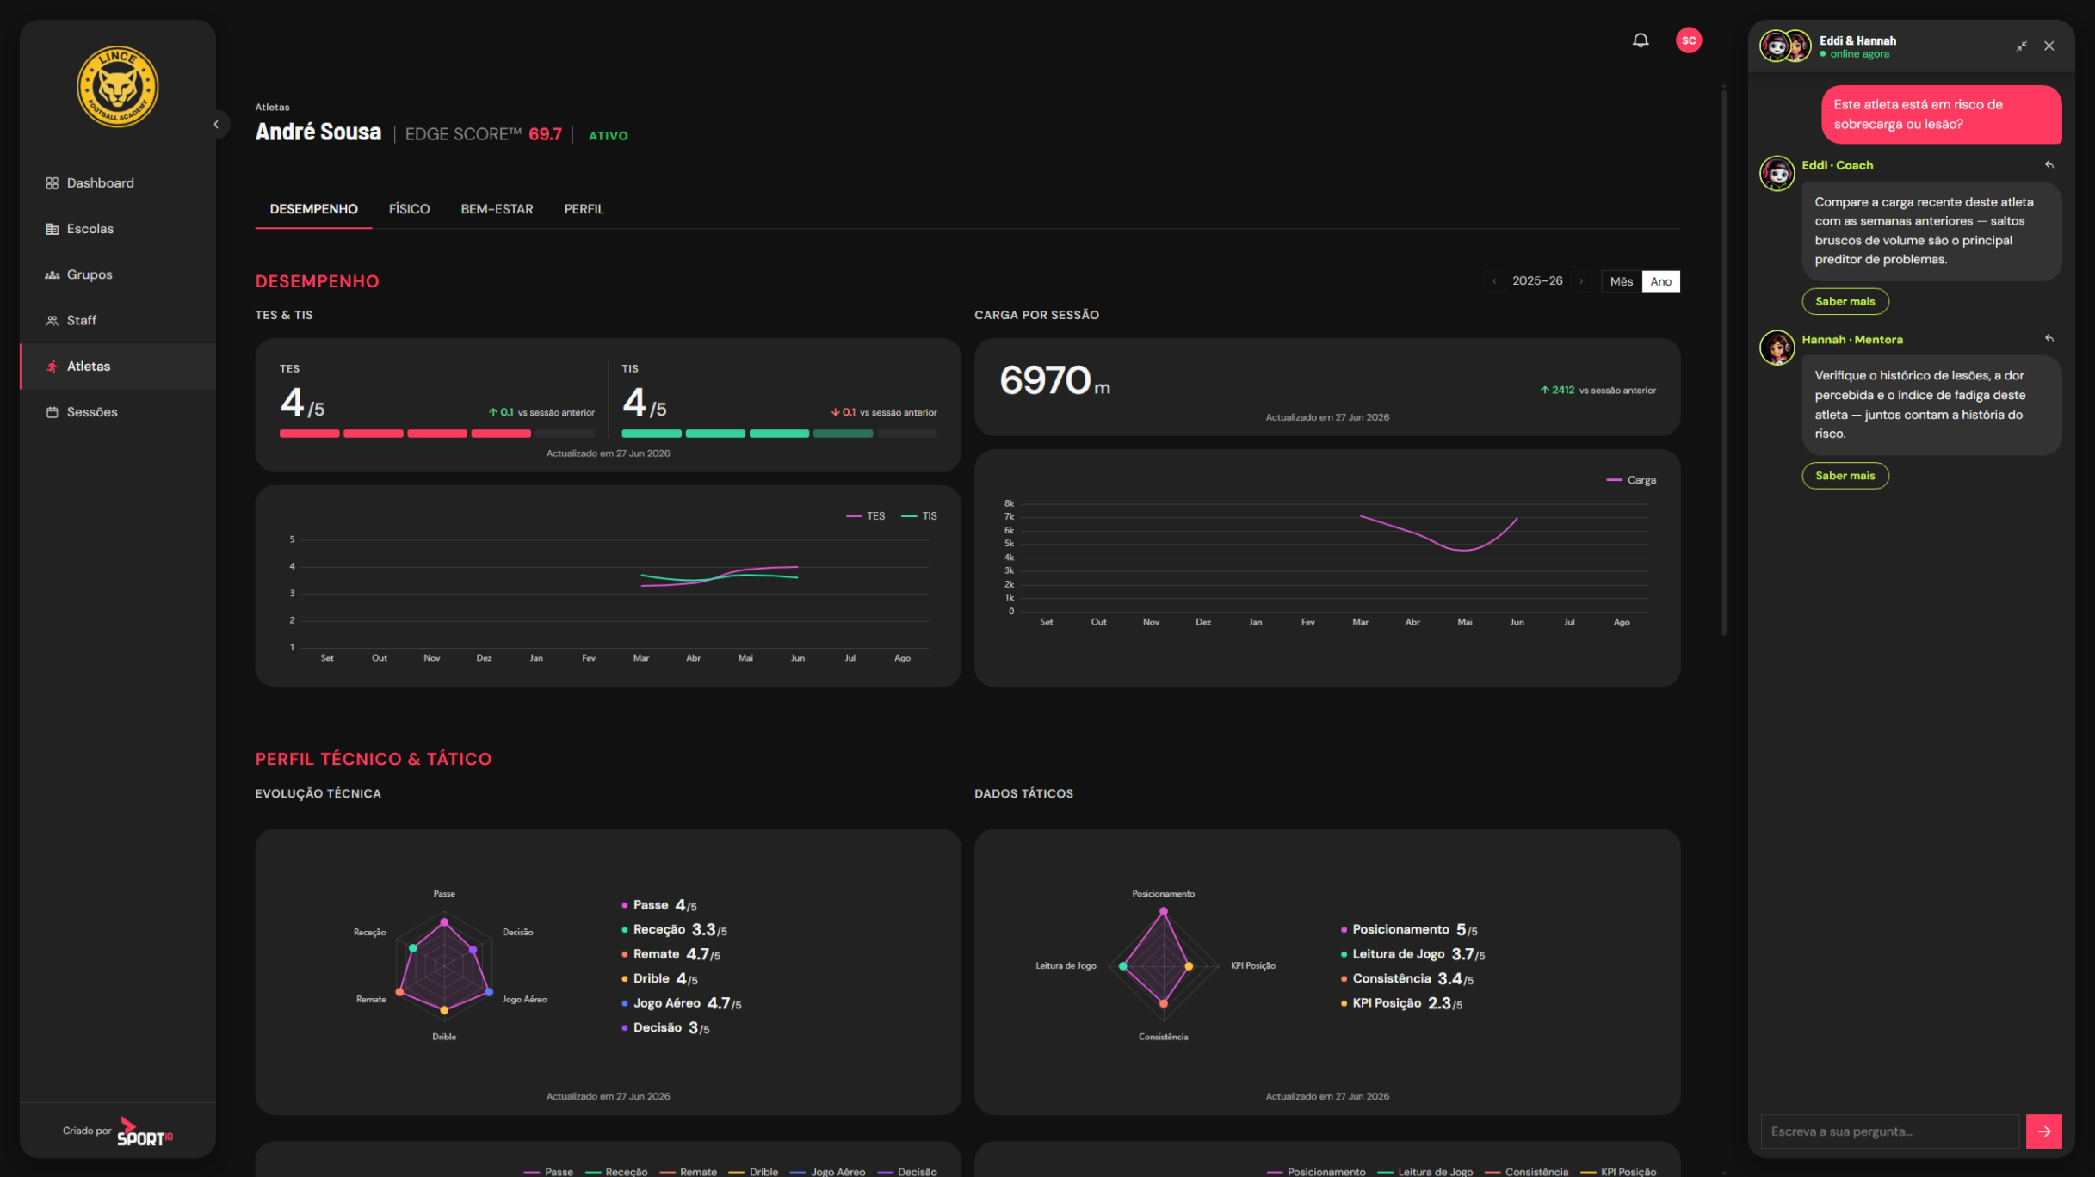

Slide 60
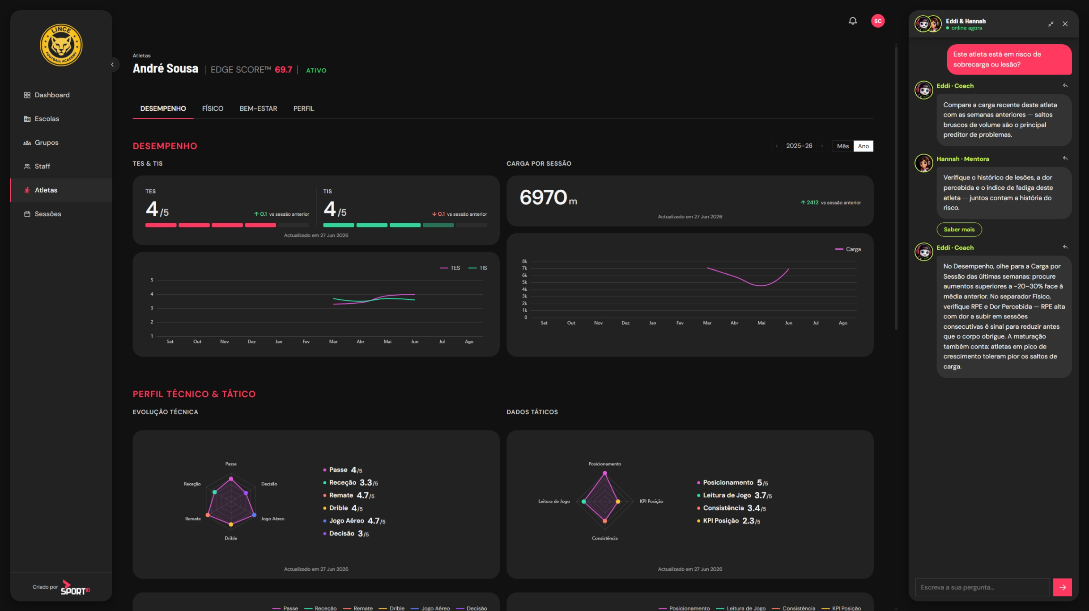

Slide 61
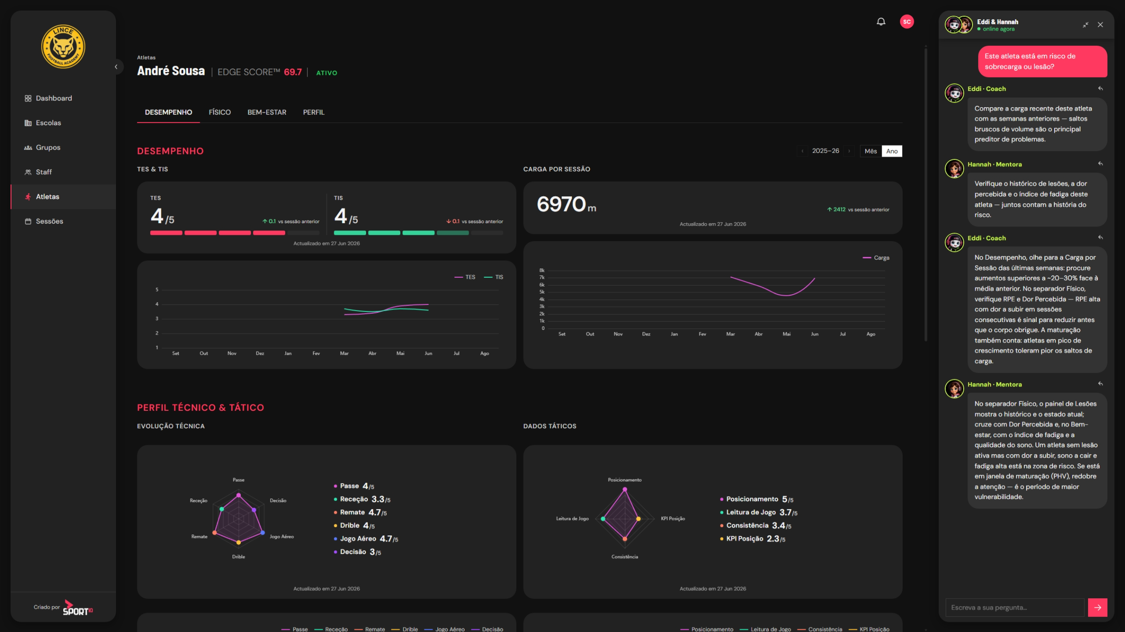

Slide 62
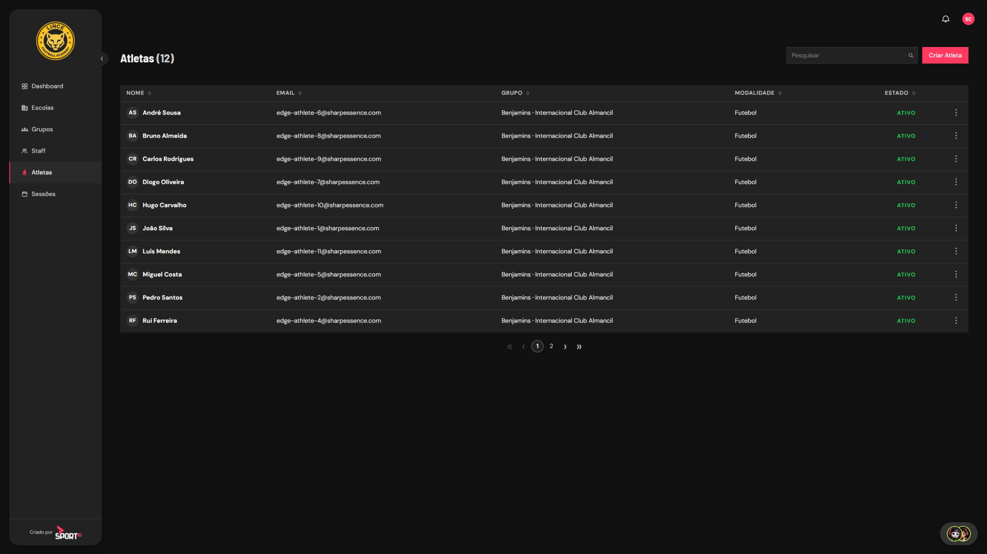

Slide 63
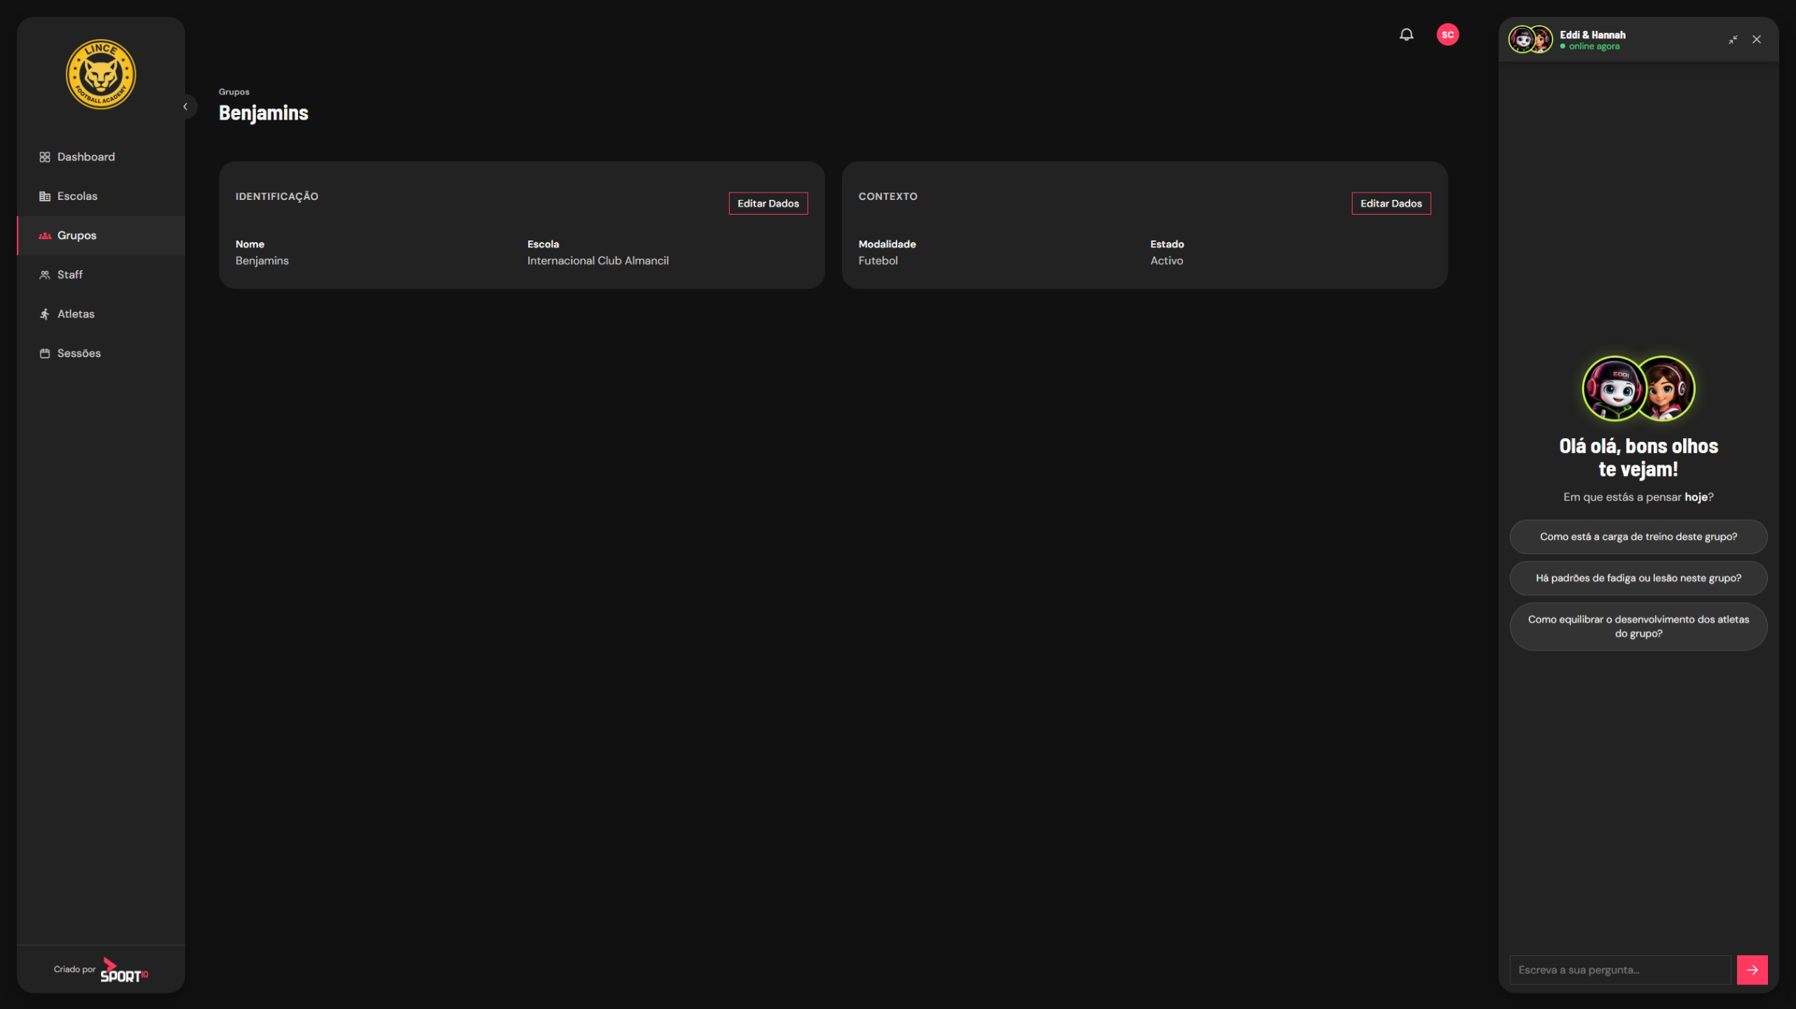

Slide 64
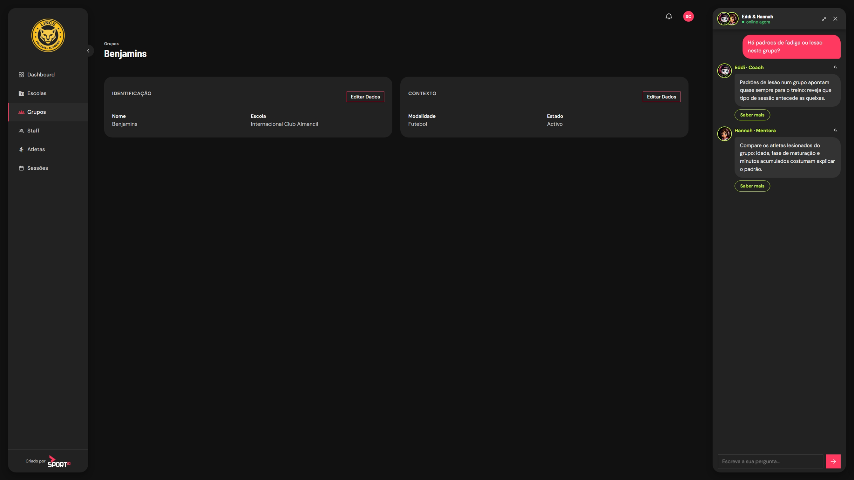

Slide 65




05 THE PROJECT SPORT IQ
Privacy & Security First.
YOUR DATA, YOUR INSTANCE
ENCRYPTED
END TO END
BACKUPS YOU'LL PROBABLY NEVER NEED
STORED
IN EUROPE
Every client runs on a fully separate instance with its own database.
No shared tables, no crossover, no exceptions.
Sensitive data is encrypted at rest and every connection runs over HTTPS. Security best practices applied by default, not on request.
Redundant, automated backups run continuously. Data loss is very unlikely — but if the worst happens, recovery is already in place.
All data is hosted on European infrastructure and never leaves it.
Aligned with GDPR from the ground up.

Slide 66
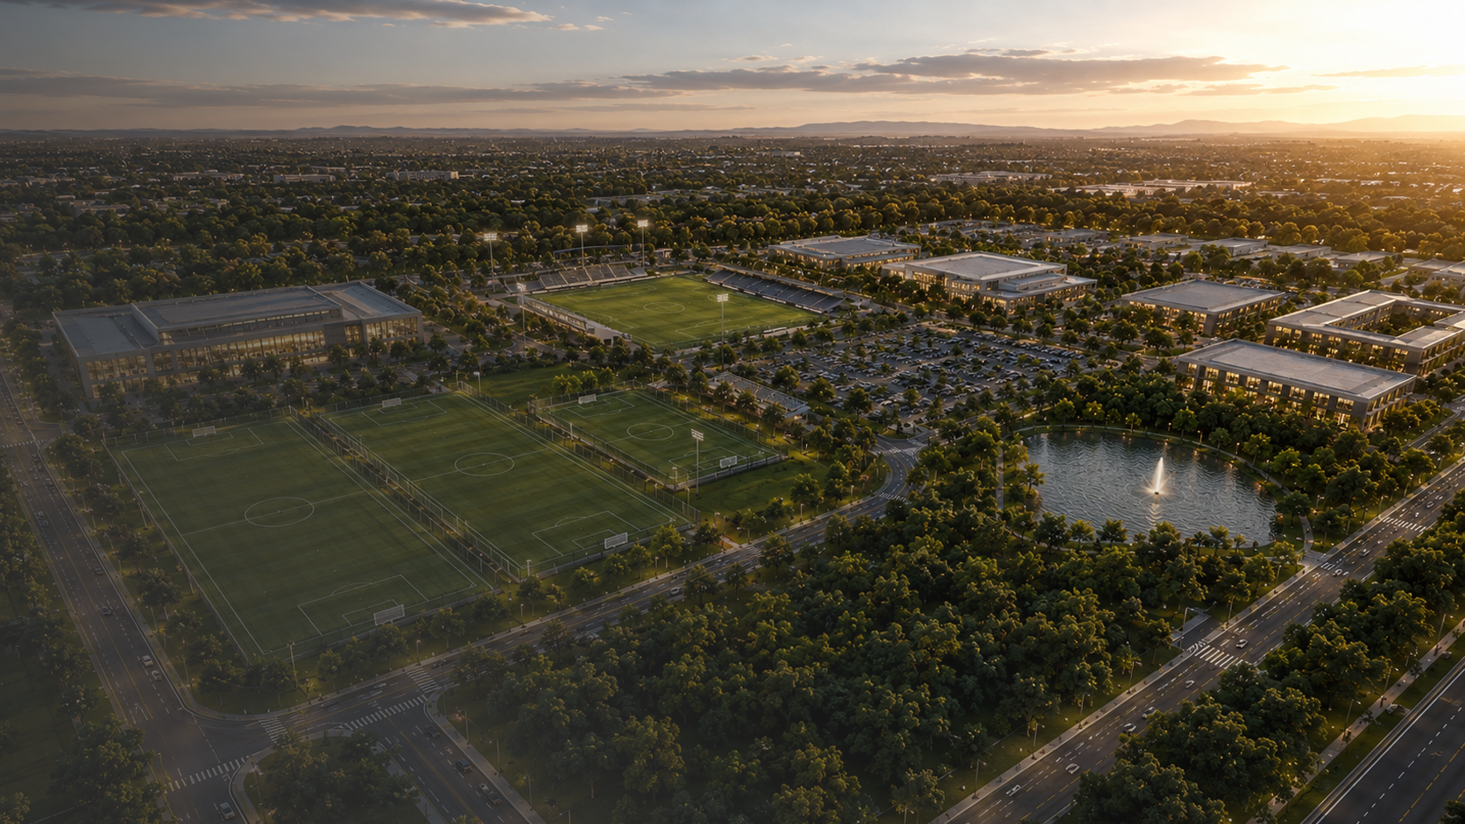
SPORT IQ HUMAN PERFORMANCE LAB CITY
Integrated Academy of Training,
Performance and Education.

Slide 67
SPORTS IQ Human Performance Lab CITY.
01 Vision

Slide 68






01 VISION
Vision.
To create one of the most complete sports development centres in the Iberian Peninsula, integrating sporting and academic training, development training, education and high performance, technology, accommodation, health and wellbeing.
Much more than an academy. An integrated ecosystem of human development, performance and innovation, designed to shape athletes, students and citizens ready for the challenges of the future.
HUMAN DEVELOPMENT
HIGH-LEVEL PERFORMANCE
DUAL EDUCATION
INTERNATIONAL CAMPS
APPLIED TECHNOLOGY
HOLISTIC WELLBEING

Slide 69
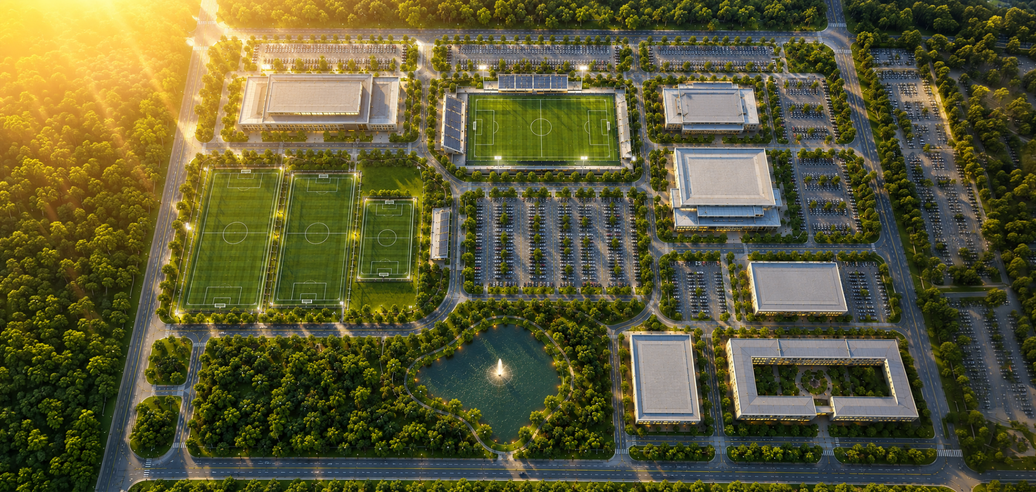
01 VISION
HOTEL
FOOTBALL FIELDS
ATHLETES' RESIDENCE
MULTIUSE ARENA
CLUBHOUSE
HUMAN PERFORMANCE CENTER
02 / 20

Slide 70
SPORTS IQ Human Performance Lab CITY.
02 Masterplan

Slide 71






02 MASTERPLAN
AREA OF EACH HUB
m²
MASTERPLAN:
3 HECTARES (30.000 M²).
FOOTBALL PERFORMANCE
18.000
HUMAN PERFORMANCE CENTER
3.000
SPORTS RESIDENCE
2.500
Not to build a "city". To create an integrated centre of human development and sports performance. Inspired more by centres of excellence than by giant academies.
MULTIUSE ARENA
1.500
CLUBHOUSE
1.000
PARKING
1.500
GREEN SPACES
2.500
TOTAL
30.000

Slide 72
SPORTS IQ Human Performance Lab CITY.
03 Hubs

Slide 73
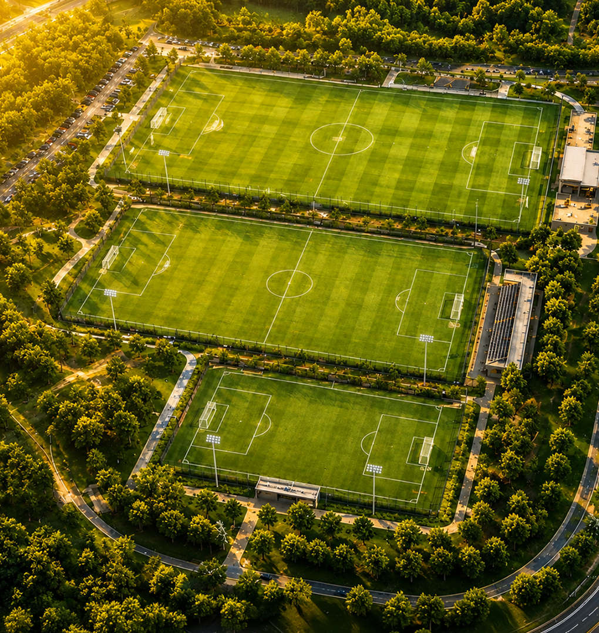







03 HUBS
HUB 1
FOOTBALL PERFORMANCE.
The heart of SPORTS IQ Human Performance Lab City, designed for training, competition, technical development and sporting events.
All fields feature:
State-of-the-art synthetic turf
Fully equipped changing rooms
Access to terrace and bar
MAIN FIELD 7.500 m²
SECONDARY FIELD 7.000 m²
SECONDARY FIELD 7.000 m²
11-a-side football
Stand capacity: 300
Use: Official Matches and Events
11-a-side football
Stand capacity: 100
Use: Training Matches and Competition
7-a-side and 9-a-side football
Stand capacity: 100
Use: Development, Training and Competition
18.000m² dedicated to the technical, competitive and developmental growth of athletes.

Slide 74
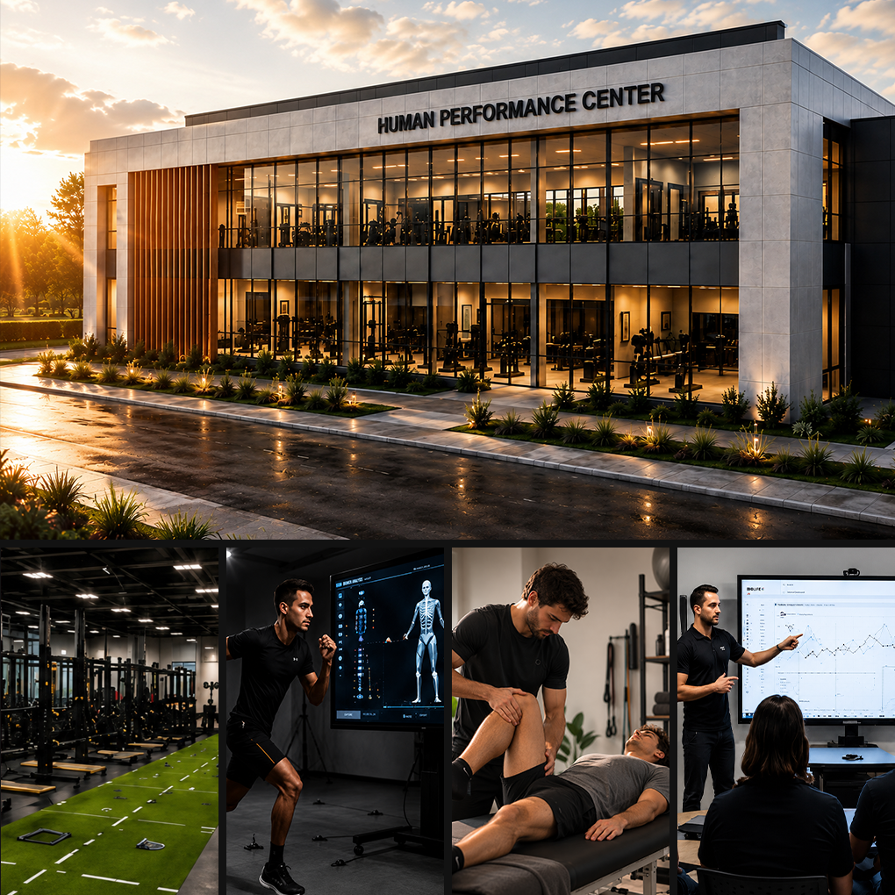










03 HUBS
HUB 2
HUMAN PERFORMANCE CENTER.
Advanced centre of science, innovation and human development, integrating technology, health and performance across all its dimensions.
MAIN BUILDING 3.000 m²
FLOOR 0
Gym
Strength
Power
Mobility
FLOOR 1
Biomechanics
Video analysis
AI applied to sport
Training rooms
FLOOR 2
Sports medicine
Physiotherapy
Nutrition
Psychology
Science, technology and health at the service of performance. A centre of excellence to train, develop and empower high-performance athletes.

Slide 75









03 HUBS
HUB 3
SPORTS RESIDENCE.
Premium accommodation for athletes, teams and visitors, with complete facilities for comfort, focus and recovery.
RESIDENCE 2.500 m²
HOTEL 1.500 m²
Capacity: 60 athletes
30 Twin Rooms
Study rooms
Common rooms
Dining hall
60 Twin / Double Rooms
Families
Visiting teams
Trainers
Welcome, care and empower. Everything athletes and teams need to reach their best performance.

Slide 76
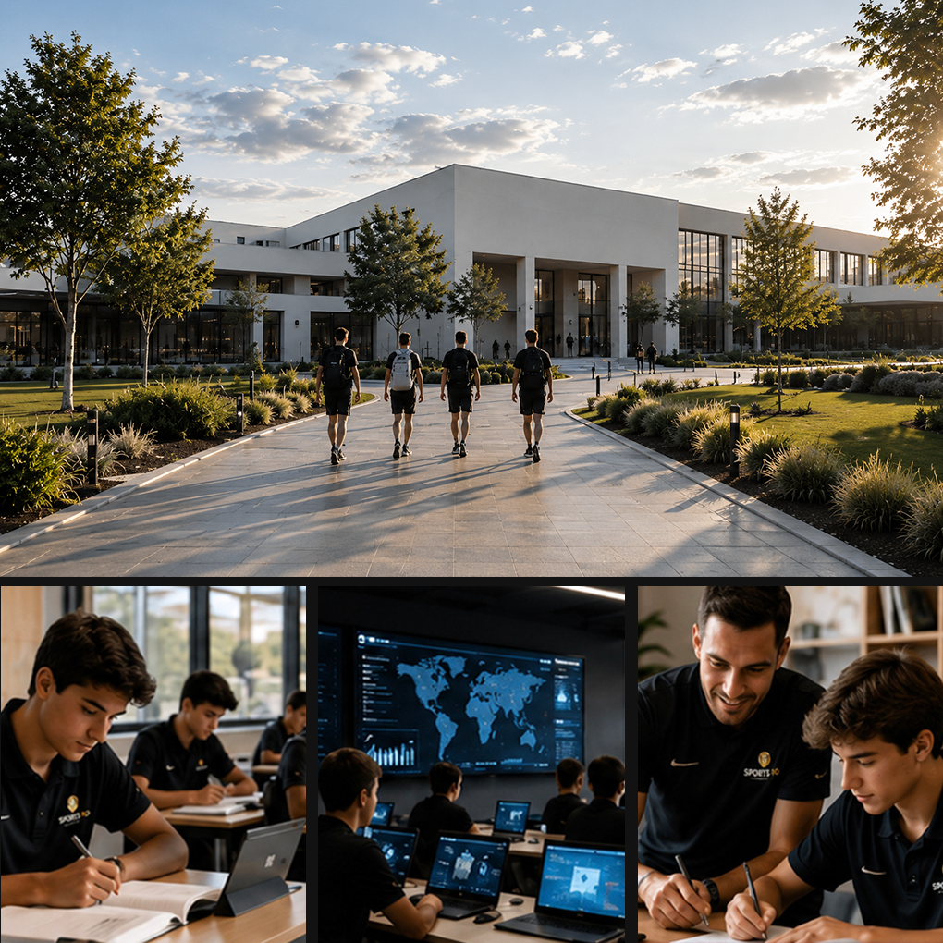








03 HUBS
HUB 4
SPORTS IQ SCHOOL.
International Education for High-Potential Athletes.
STRATEGIC PARTNERSHIPS
Capacity for 100 student-athletes integrated into partner schools and supported by the Sports IQ programme
EDUCATIONAL MODEL
Hybrid and in-person learning
Athlete support
Academic tutoring
Global skills
Digital and AI literacy
Personal development
Education and performance. Shaping athletes ready to compete in sport and win in life.

Slide 77
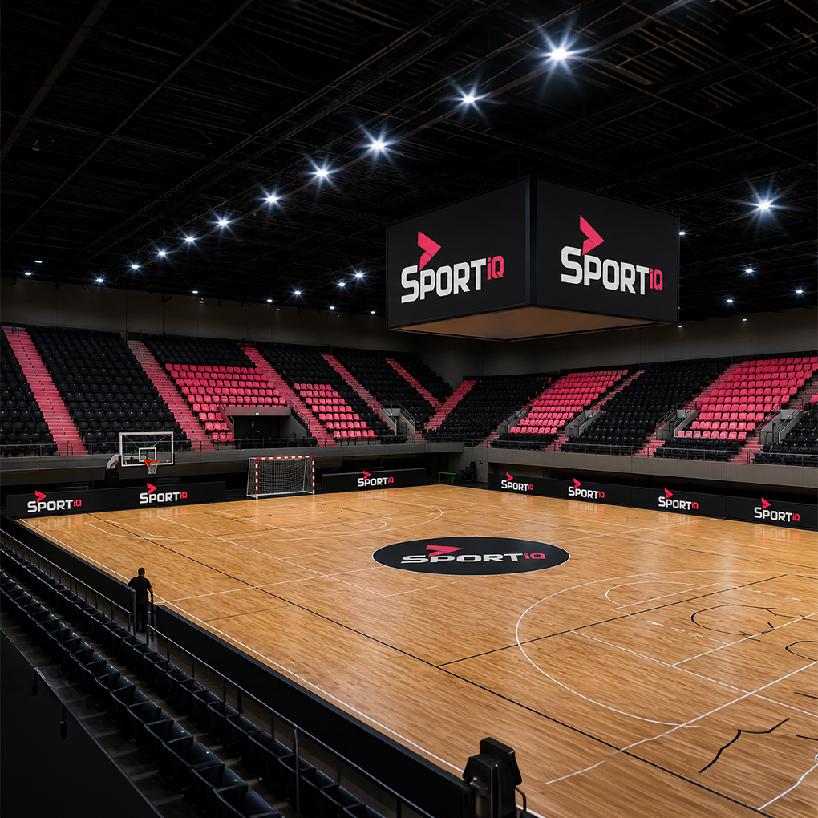









03 HUBS
HUB 5
MULTIUSE ARENA.
A versatile, modern space for training, competition and high-level events.
FUTSAL
BASKETBALL
HANDBALL
CAPACITY
500 SEATS
EVENTS
CONFERENCES
One space, infinite possibilities. Train, compete, inspire and connect
High-performance sports flooring
State-of-the-art LED lighting
Top-tier audiovisual systems
Modern, flexible infrastructure

Slide 78
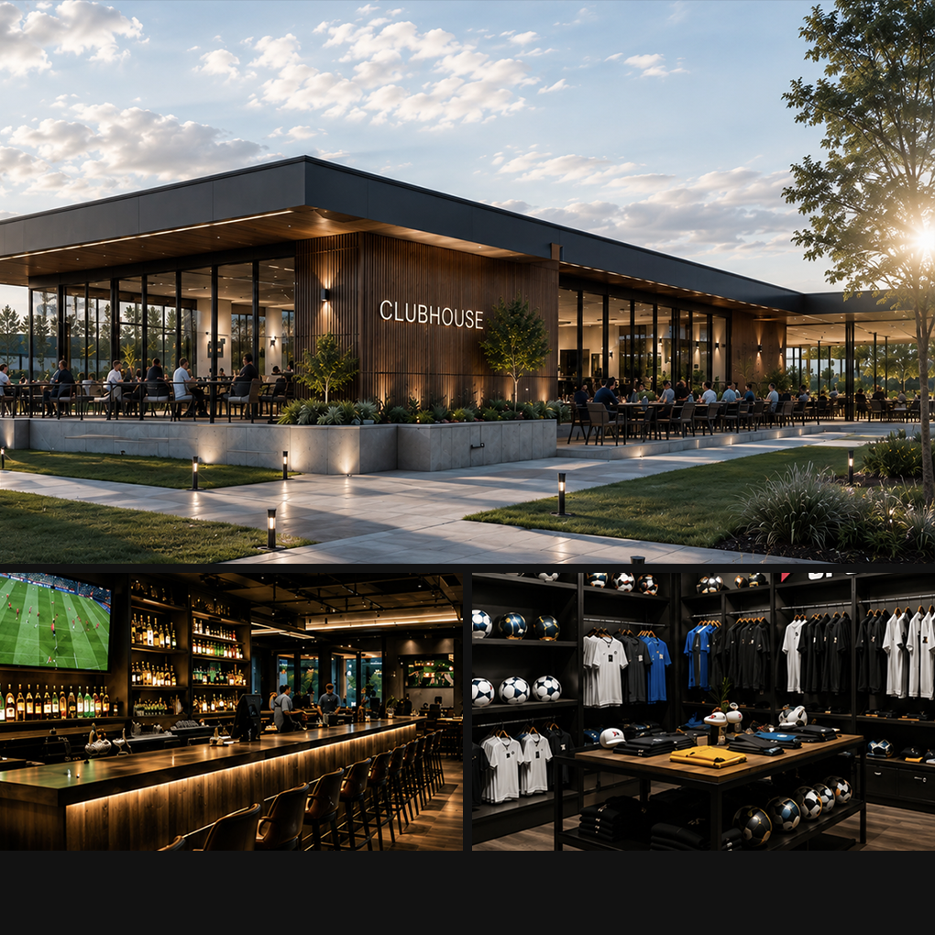





03 HUBS
HUB 6
1.000 M² CLUBHOUSE.
The meeting point of the Sports IQ community. Comfort, networking and a premium experience.
BAR
RESTAURANT
LOUNGE
SPORTS PRODUCTS STORE
3 MEETING ROOMS
WORKSPACE FOR 15 STATIONS
Connection. Experience. Excellence. A space designed to inspire, build relationships and unlock opportunities.
High-speed Wi-Fi
Private parking
Outdoor terrace
24h controlled access

Slide 79
SPORTS IQ Human Performance Lab CITY.
04 THE SPORT IQ DIFFERENCE

Slide 80
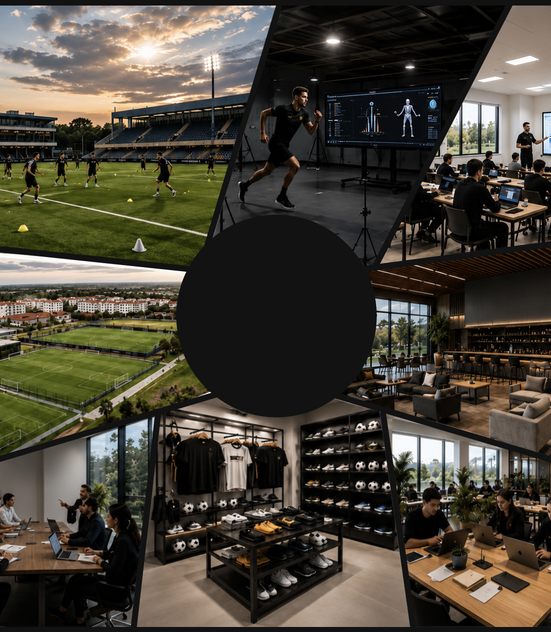









04 THE SPORT IQ DIFFERENCE
THE SPORT IQ DIFFERENCE.
SPECIALIZATION IN:
HUMAN AND SPORTS DEVELOPMENT
SPORTS PERFORMANCE
TECHNOLOGY APPLIED TO SPORT
DUAL EDUCATION (SCHOOL + SPORT)
INTERNATIONAL CAMPS
SPACES FOR TRAINING, WORK, ETC.
An integrated vision.
From training to education, from technology to learning, from the athlete to the community.
Excellence.
International standards across every area.
Impact.
We shape better athletes, better people and a better future.
Global connection.
International partnerships, global experiences, opportunities without borders.

Slide 81

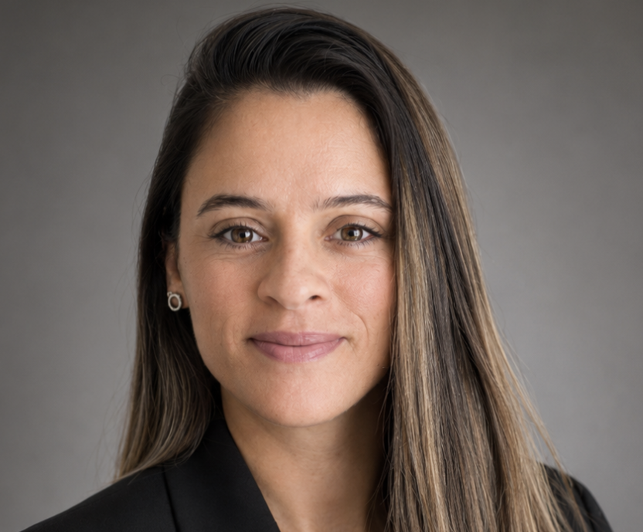





The Founder Team.
LUÍS RASQUILHA
MARCELA BIANCHI
JOSÉ BORRALHO
RUI MARANHÃO
SÉRGIO COSTA
DANIEL ALEXANDRE
FILIPA MACHADO

Slide 82
Thank You.

